Slide 1
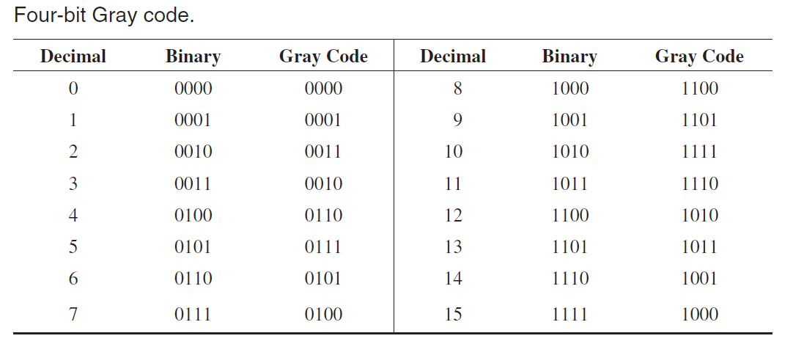
Gray Code
Exhibits only a single bit change from one code word to the next in sequence

Slide 2
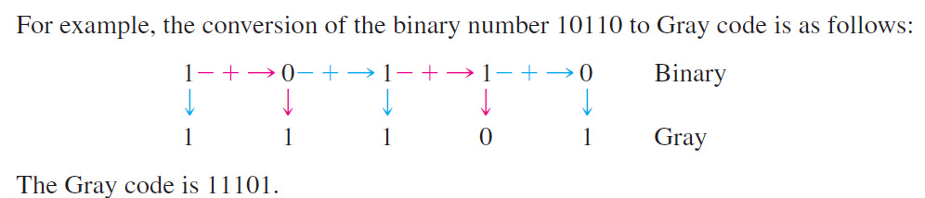
Binary to Gray Code Conversion
The following rules explain how to convert from a binary number to a Gray code word:
The most significant bit (left-most) in the Gray code is the same as the corresponding MSB in the binary number.
Going from left to right, add each adjacent pair of binary code bits to get the next Gray code bit. Discard carries.

Slide 3
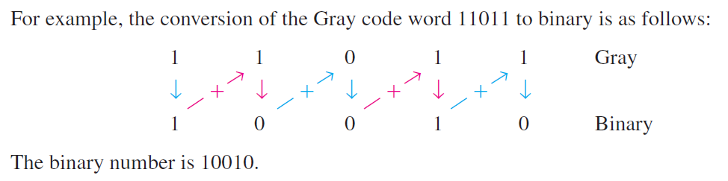
Gray-to-Binary Code Conversion
The following rules apply:
The most significant bit (left-most) in the binary code is the same as the corresponding bit in the Gray code.
Add each binary code bit generated to the Gray code bit in the next adjacent position. Discard carries.

Slide 4
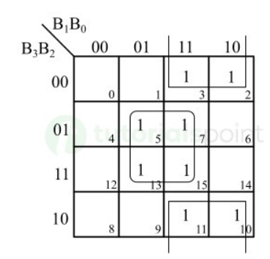
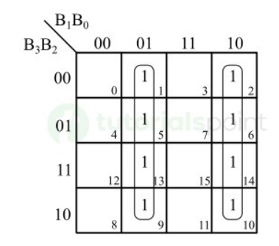


Four-bit binary to Gray conversion logic.
K-Map for Gray Code Bit G₀
K-Map for Gray Code Bit G₁

Slide 5
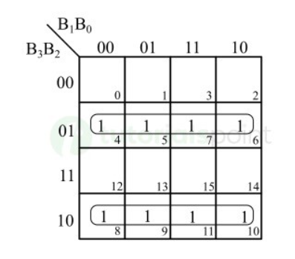
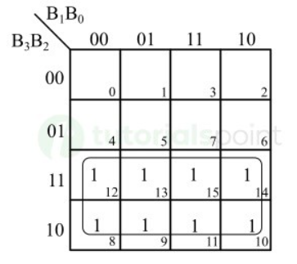


Four-bit binary to Gray conversion logic.
K-Map for Gray Code Bit G₂
K-Map for Gray Code Bit G₃

Slide 6
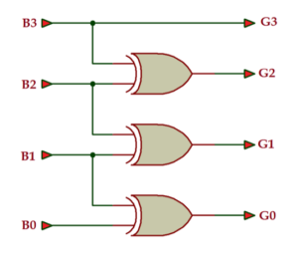
Four-bit binary to Gray conversion logic.
This circuit can convert a 4-bit binary number into an equivalent gray code.

Slide 7
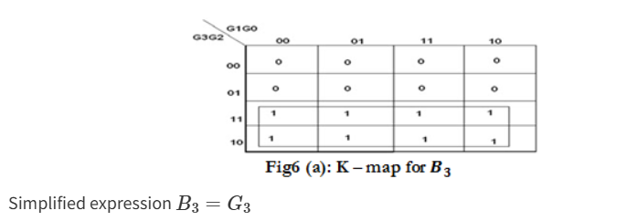
Four-bit Gray to binary conversion logic.

Slide 8
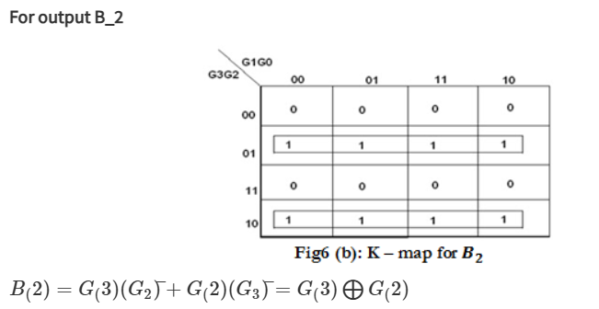
Four-bit Gray to binary conversion logic.

Slide 9
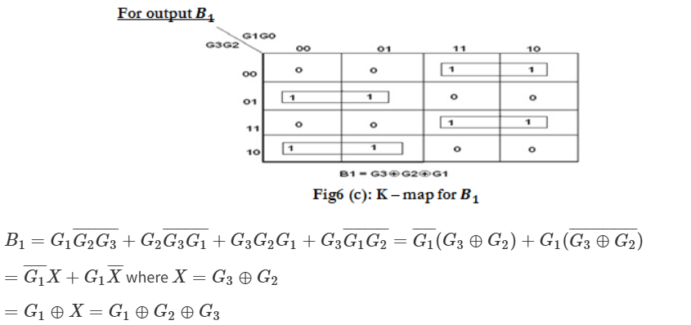
Four-bit Gray to binary conversion logic.

Slide 10
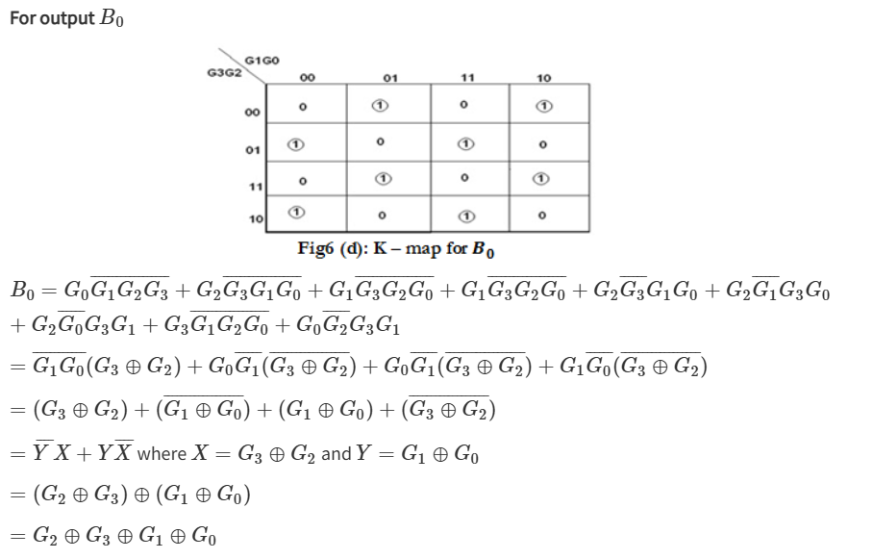
Four-bit Gray to binary conversion logic.

Slide 11
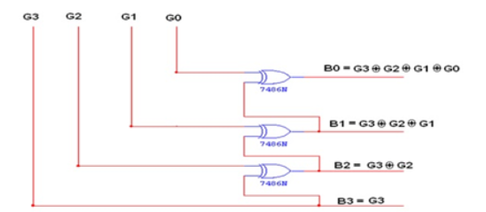
Four-bit Gray to binary conversion logic.

Slide 12
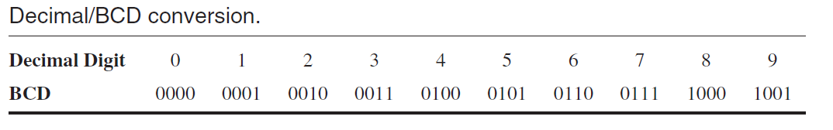
Binary coded decimal (BCD) - 8421 BCD Code
Binary coded decimal (BCD) is a way to express each of the decimal digits with a binary code. There are only ten code groups in the BCD system, so it is very easy to convert between decimal and BCD
Invalid Codes: The six code combinations that are not used—1010, 1011, 1100, 1101, 1110, and 1111—are invalid in the 8421 BCD code.

Slide 13
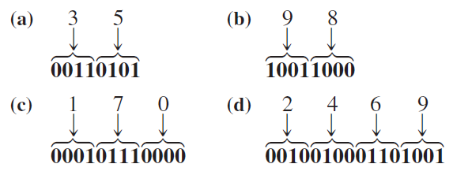
Decimal to BCD
To express any decimal number in BCD, simply replace each decimal digit with the appropriate 4-bit code,
Convert each of the following decimal numbers to BCD:
(a) 35 (b) 98 (c) 170 (d) 2469

Slide 14
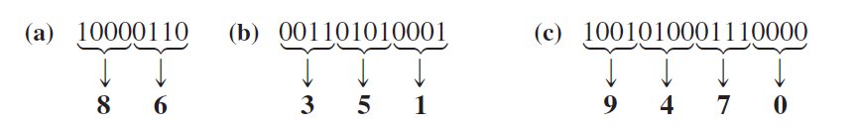
BCD to Decimal
Start at the right-most bit and break the code into groups of four bits. Then write the decimal digit represented by each 4-bit group.
Convert each of the following BCD codes to decimal:
(a) 10000110 (b) 001101010001 (c) 1001010001110000

Slide 15
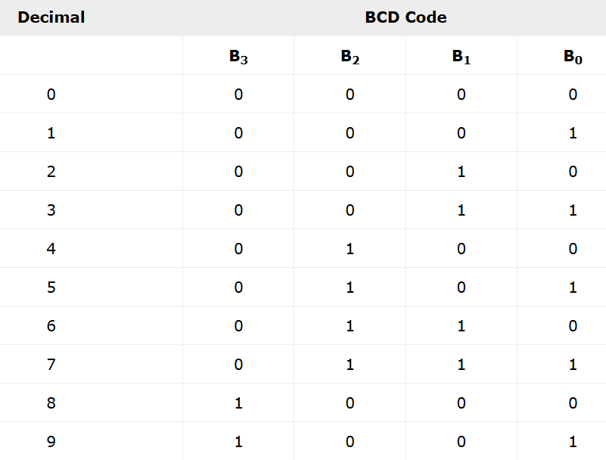
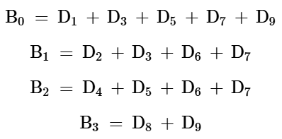
Decimal to BCD Converter
The Boolean expressions for converting decimal to BCD are given below

Slide 16
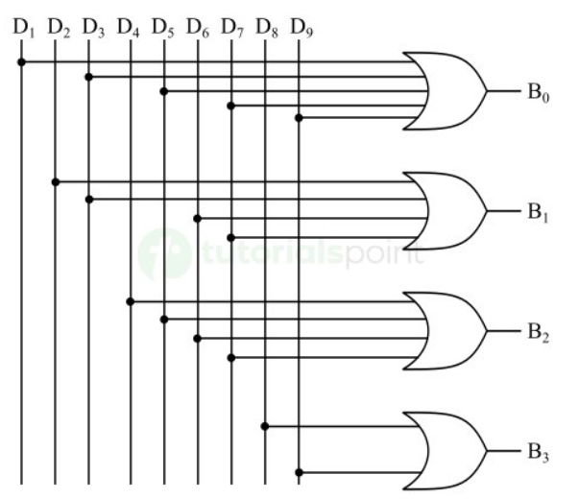
Decimal to BCD Converter

